Slide 1
Establishment of Solar Thermal Centres of Competence in Namibia: Training of staff of Vocational Training Centres.
Helvi Ileka
Centre for Renewable Energy and Energy Efficiency
Namibia Energy Institute
Namibia University of Science and Technology
(NUST)

Slide 2
Outline
Introduction
Focus of SOLTRAIN I and II in Namibia
Establishment of Centre of Competence under the framework of SOLTRAIN Project
Collaboration with National Housing Enterprise
Conclusions

Slide 3
Introduction
Namibia ~ 40 % electrification
Installed Capacity: 332MW hydro, 120MW coal & 24MW diesel.
Peak demand surpassed 534MW
~ 60 % of national demand of electricity is imported from regional partners through SAPP
of which most of agreements have ended in 2015
Expected Deficit from 2016
Namibia’s Direct Normal Irradiation(DNI) ranks among the highest in the world
Strong case for solar water heating as a demand side management intervention in Namibia
Notes:
Imports are almost half of the demand
Slight dip in consumption in 2009 compared to 2008. Demand-side Management activities could be attributed to this dip

Slide 4
Policy Framework on Solar Thermal and opportunities
Government promotes the use of renewable energy through the establishment of:
An adequate institutional and planning framework;
Development of human resources;
Public awareness;
Suitable financing systems, e.g., Solar Revolving Fund (SRF);
Cabinet directive on solar water heaters –since 2007
Soltrain Project – since 2009;
EIF-SME Bank Green soft loan scheme – since 2013.
A regulated renewable energy industry that promotes & adopts quality standards
Development of Solar Thermal Market in Namibia through policy and appropriate legislation

Slide 5
Focus of SOLTRAIN I and II
SOLTRAIN I | SOLTRAIN II
Awareness campaigns to the public | Focused awareness campaigns
Marketing, installing and Monitoring of improved demonstration systems | Solar thermal Demonstration Systems
Training | Centres of Competence
Assistance to producers | Solar Thermal Technology Platforms
Vocational Training Centres capacitated as Centres of Competence

Slide 6
STTP develops the strategy for growth
Vision for 2030:
0.5m² of collector
per inhabitant
Today:
<1% of low
temperature heat
y
g
e
t
r
a
S
t
2013
2015
2020
2030
Notes:
SLIDE IS HEAVILY ANIMATED! The two pie-charts relate to the previous to presentations: Gerhard Stryi-Hipp will explain were solar thermal is today, and Werner Weiss will present our vision for 2030. You then show that the ESTTP is the means to develop the strategy to come A to B…

Slide 7
Structure of NAM STTP
Coordination
NEI-CREEE
Ministry of Works
Higher Education
VTCs?
Industry
Solar Companies
NAMPOWER
VISION: 0.5 m² of solar thermal collector area per habitant in Namibia by 2030.
20.000 SWH
Households
450 commercial
Systems
In next 5 years
13.6 MW avoided
Govt. buildings
Directive available
Program? Vision?
Policy framework?
Curriculum
Applied research
Quality standards
Training
Install high quality SWH systems
Manufacturing
…
Financial institutions, Environmental Investment Fund
Ministry for Mines and Energy: Revolving Fund

Slide 8
The Namibia Energy Institute as a Centre of Competence
Developing the value chain for establishment of solar thermal technology industry: registration of suppliers and installers
Developing the standards for the products related to solar thermal technologies, e.g., solar water heating, and code of practice for installation, and maintenance of solar thermal systems in Namibia (TCI, NSI and MME)
Train service providers involved in sourcing, installation, and maintenance of solar thermal systems excl. inspectors
Developing instruction manuals for installers, inspectors, maintainers and users of solar thermal technologies

Slide 9
Establishment of satelite Centres of Competence
Carry out comprehensive training programmes ranging from practical hands-on training to application oriented training of already skilled installers on different types of solar thermal applications
Will act as one of the focal points for Solar Thermal information, training, support for industry and policy, as well as for applied research in the regions.
Institutions of Higher Education Coordinated by NEI
Collaborate with other Endulink projects (SASEI,PARTICIPIA, NEED and PEESA )on specialised Master Programmes
All Vocational Schools in Namibia
Engage National Training Authority (NTA) for curriculum development programmes;
Unit standards were developed and approved with assistance of GIZ , L1-L5 cont…

Slide 10
Funding for demonstration systems at VTC’s
Institution | Soltrain (Euro) | OFID (Euro) | EIF (N$) | MME (N$)
NUST CoC |  | 22 500
Windhoek VTC |  | 22 500
Rundu VTC | 3,500 |  | 50,000
Zambezi VTC | 3,500 |  | 50,000
Okakarara VTC | 3,500 |  | 50,000
Valombola VTC | 3,500 |  |  | 75.000
Eenhana VTC | 3,500 |  |  | 75.000
TOTAL | 17,500 | 45,000 | 150,000 | 150,000
To instil a sense of ownership, VTC’s contribute financially as well

Slide 11
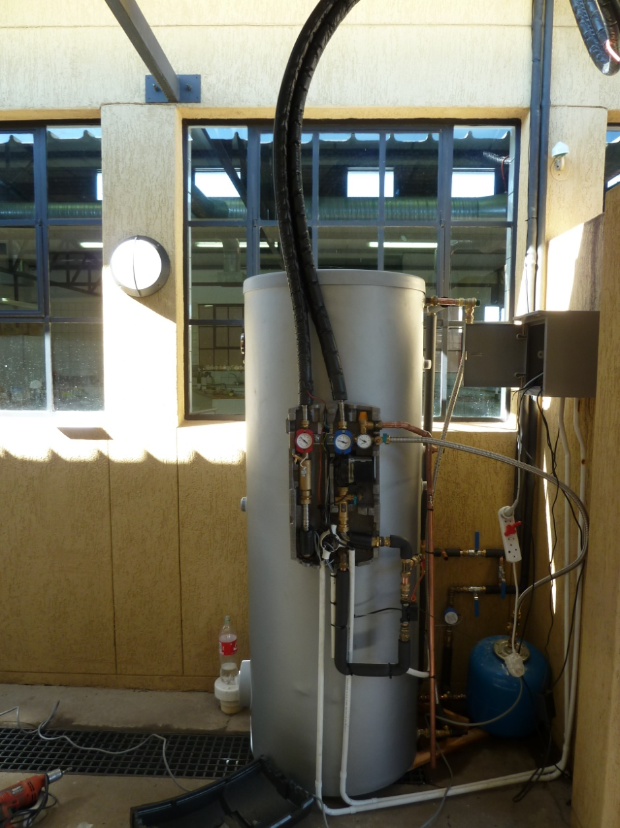
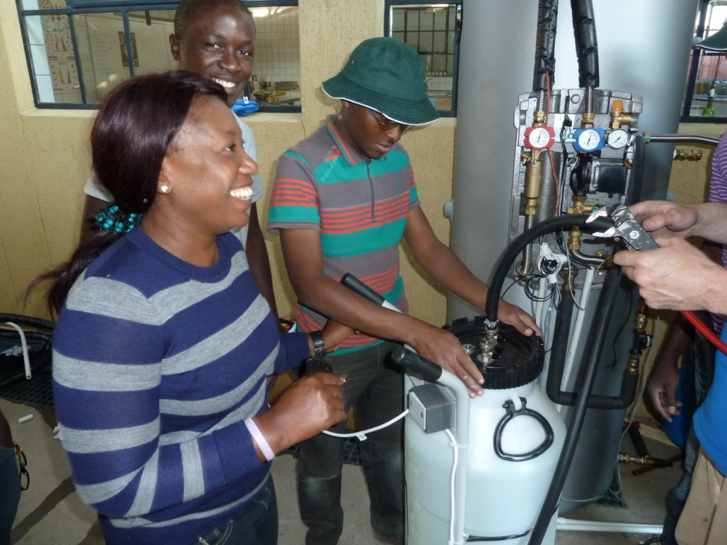
NUST : Date of installation 29 April 2013
Complete system with monitoring equipment.
Two - Polytechnic of Namibia Students have written their degree theses on the systems

Slide 12
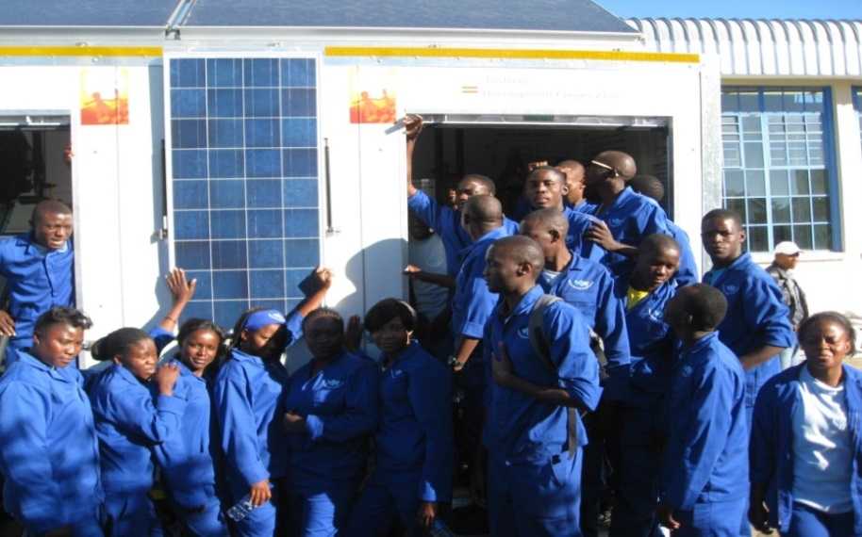
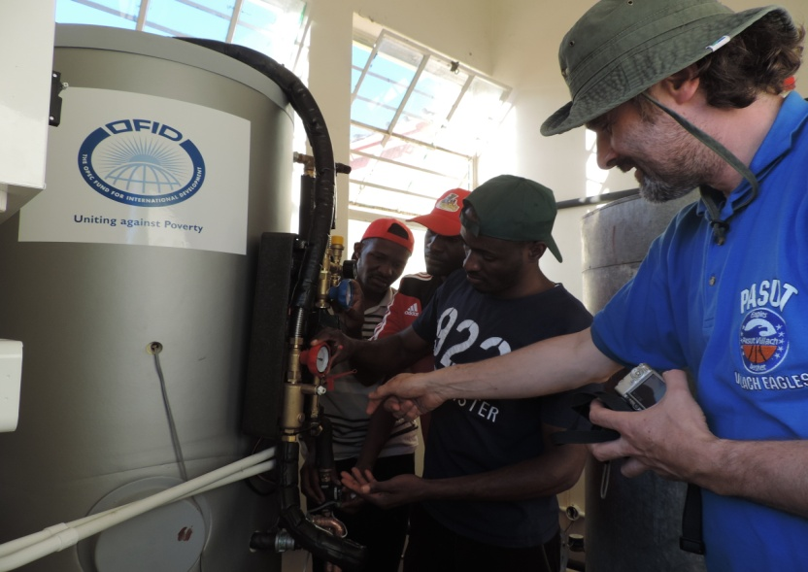
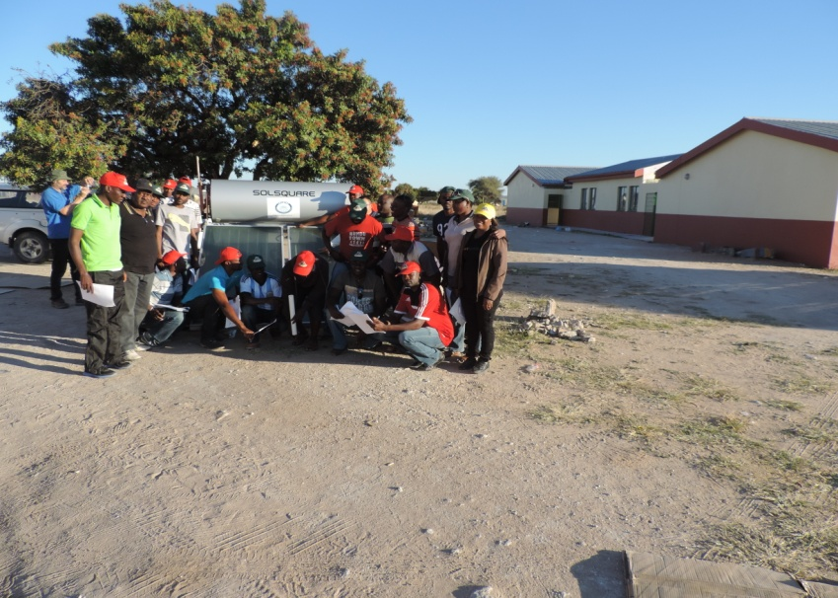
Systems installed at 6 VTC’s + 1 National Youth Service Centre
Pumped Systems installed by Instructors at Valombola, Rundu, Eenhana, Okakarara, Windhoek and Zambezi

Slide 13
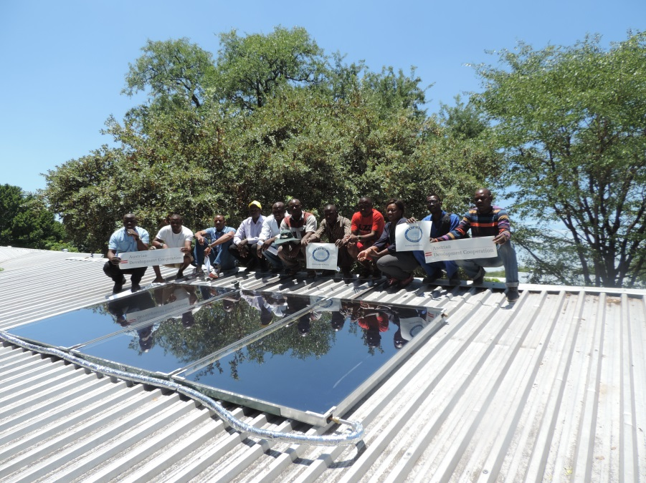
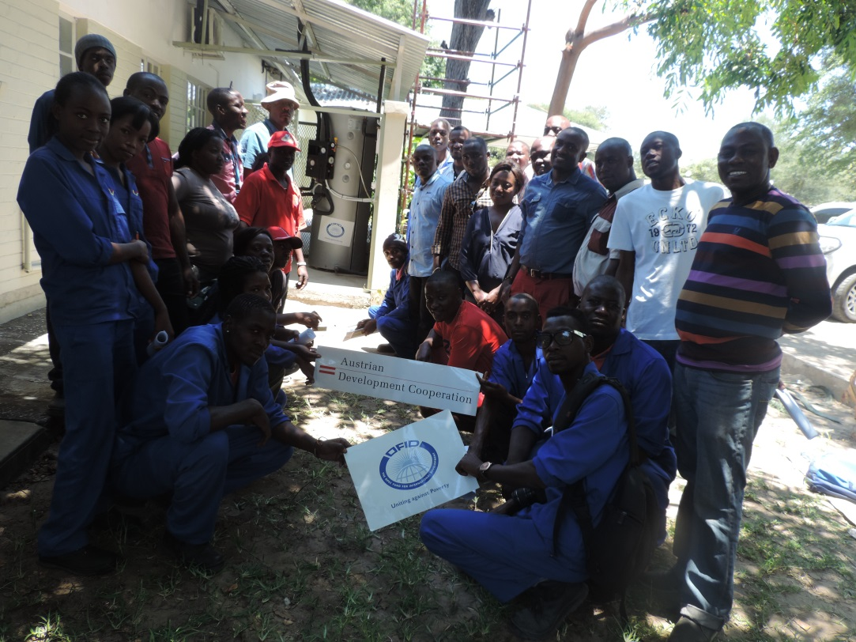
Zambezi VTC was installed in February 2015

Slide 14
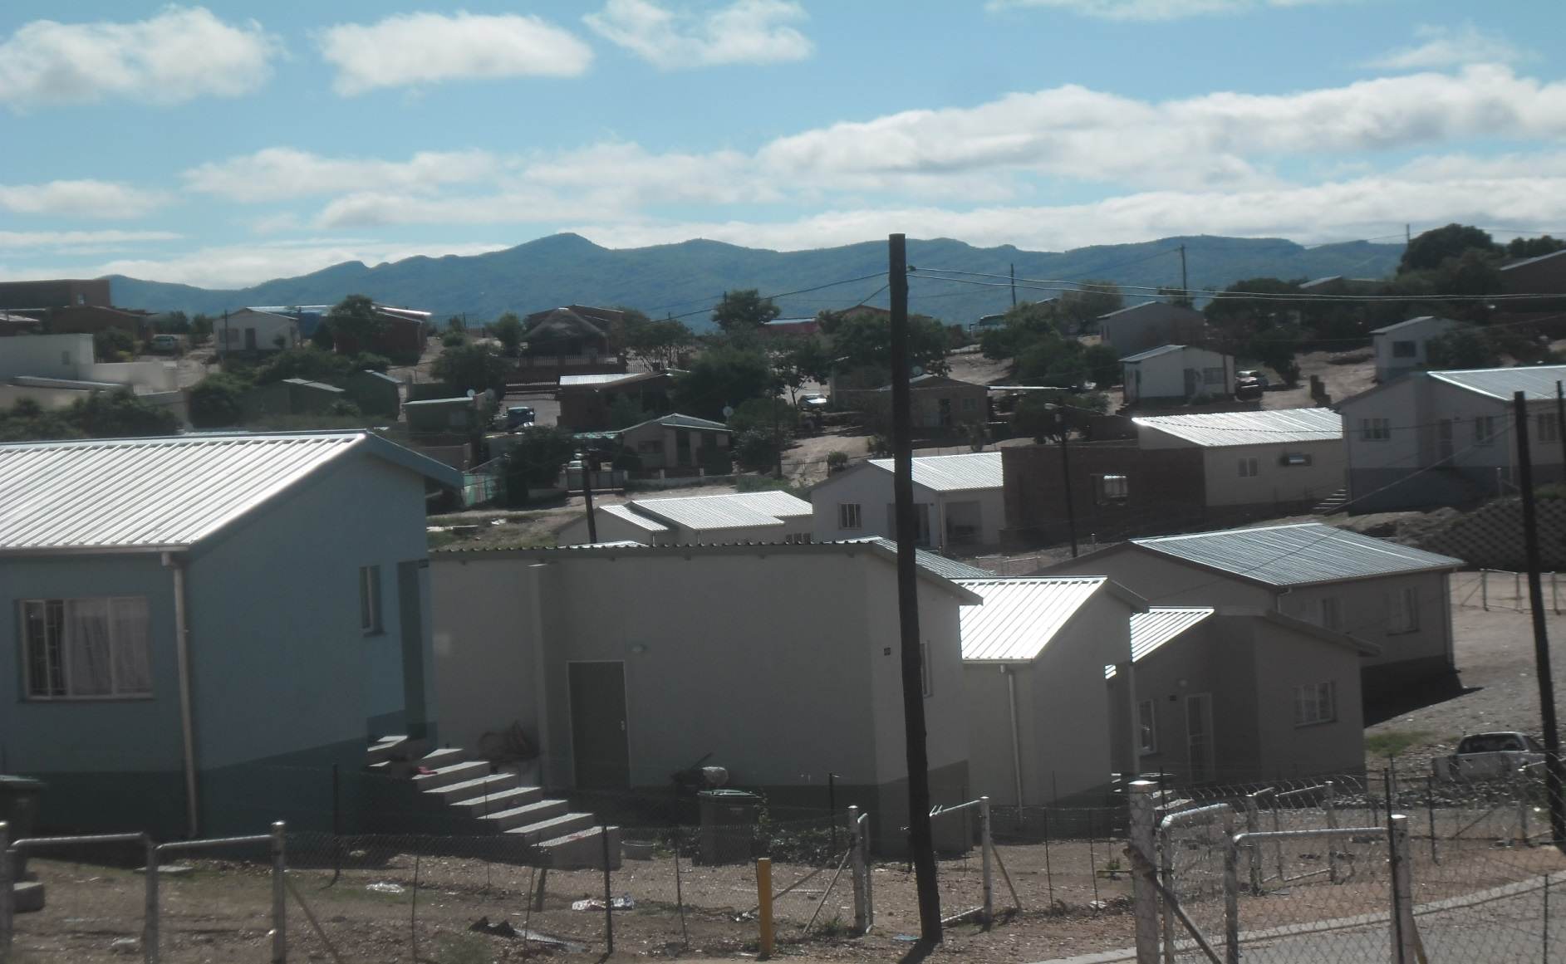
Collaboration with National Housing Enterprise
SOLTRAIN Contribution 50%
Namibian Government (Ministry of Mines and Energy 25 %
System (house) Owner through loan from NHE 25%
62 Solar Water Heaters installed as demonstration systems at low cost houses in Otjomuise in collaboration with NHE

Slide 15
SOLTRAIN’s initiative at mass housing project
Contributes and supports NamPower on Demand Side Management;
Provides proof of concept before implementation cabinet directive for public projects - NHE
Develops a flagship site for the SOLTRAIN project
The project to serve as practical site for Measuring & Verification for ECB trainees
Can serve as baseline for the low cost housing projects;
A financial model for financing SWH for the low cost houses will be developed
62 Solar Water Heaters installed as demonstration systems at affordable houses in Otjomuise in collaboration with NHE

Slide 16
62 SWH for NHE

Slide 17
62 SWH for NHE
On-line monitoring systems installed at 6 houses

Slide 18
Monitoring data
On-line monitoring systems installed at 6 houses

Slide 19
Total electricity consumption for NHE 2141 (no SWH installed)
About a third of energy demand goes to heat water

Slide 20
Total electricity consumption for NHE 2140 (SWH installed)
Zero % of energy demand goes to heat water

Slide 21
Energy balance of hot water consumption for NHE 2141 (without SWH) and NHE 2140 with Solar Water Heater
Both systems has losses but the user of 2141 pays electricity including the losses while 2140 all covered by the sun

Slide 22
Energy balance of solar input and hot water consumption for NHE 2140 (SWH installed)
losses
Although there are losses, user does not pay for used energy

Slide 23
Conclusions
Soltrain has been instrumental in the establishment of Centres of Competence in Namibia;
Centres of competence will assist in developing local capacity on solar thermal technologies, applications, adopt & enforce quality standards coordinated by NEI
One solution is to establish a local testing centre for verifying new entering the market
The User’s own financial contributions towards demonstration systems instils a sense of ownership – towards care and sustainability;
Collaboration with NHE on installing solar water heaters will inform decisions on mass installations of SWH on mass housing project.

Slide 24
THANK YOU
Namibia Energy Institute (NEI)
Email: nei@nust.na

